Slide 1


Machine Learning Approaches for Patient State Prediction in Pediatric ICUs
Muhammad Aurangzeb Ahmad^{1,2,*}, Eduardo Antonio Trujillo Rivera^{3,4}, Murray Pollack M.D.³, Carly Eckert M.D.¹, Anita Patel M.D³ and Ankur Teredesai⁵
KenSci Inc
Department of Computer Science, University of Washington Bothell
Children’s National Medical Center
School of Medicine and Health Sciences, George Washington University
Department of Computer Science, University of Washington Tacoma
* Corresponding author: maahmad@uw.edu

Slide 2
Background and Scope
We consider the problem of characterizing and predicting the condition of pediatric patients in intensive care units (ICUs)
This population is often typified by rapid changes in patient conditions which necessitate predictions that can capture transition in patient states
The assessment of patient’s condition is currently usually done using domain-based scoring systems
Useful for risk stratification and preemptive measures

Slide 3
Clinical Deterioration
Clinical deterioration is the often rapid change in the condition of a patient
A delay in recognizing the change in patient condition can lead to worse clinical outcomes, decline in quality of life and in extreme cases, even death.
While less than 2% of pediatric patients require intensive care services, those that do typically experience significant morbidity
Reducing this morbidity is highly contingent on the timely recognition of changing clinical needs.

Slide 4
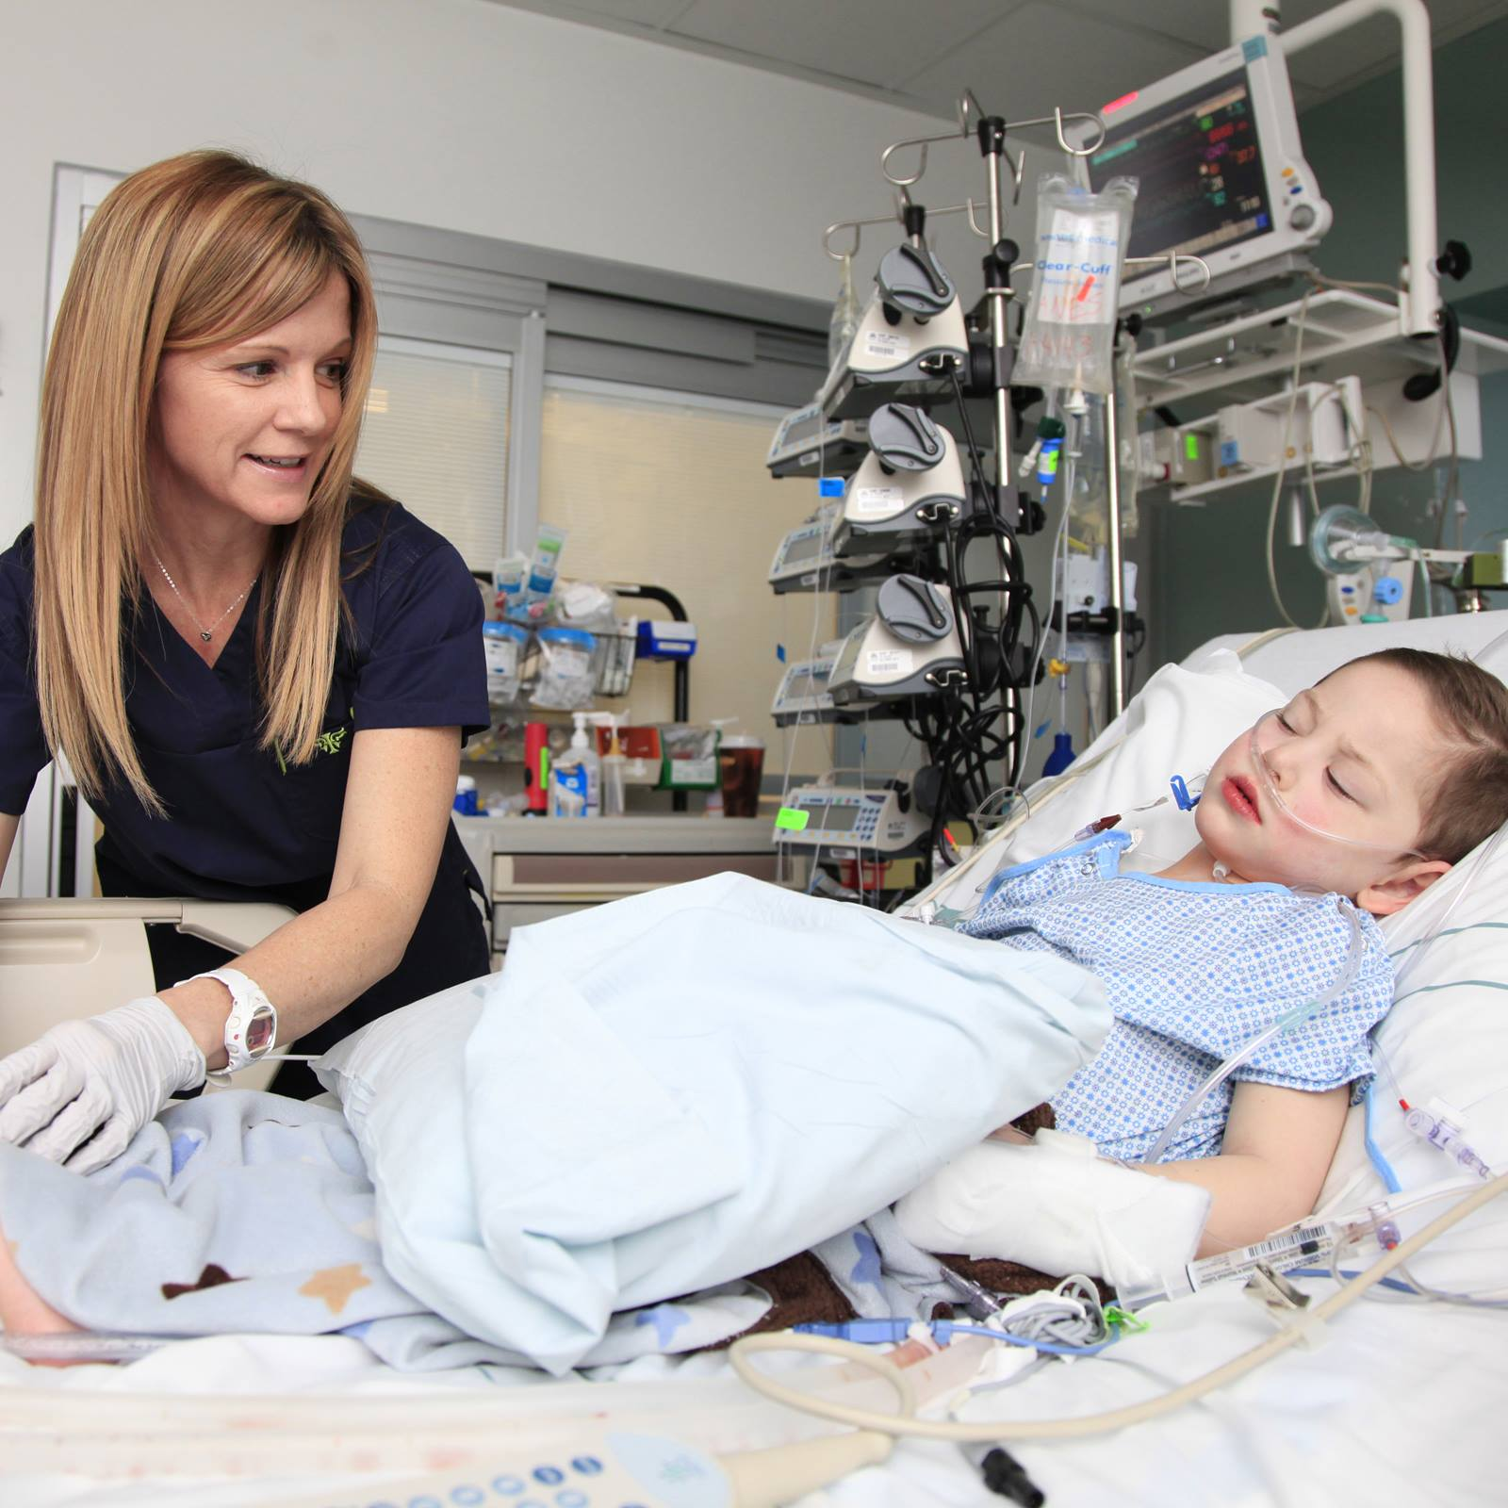
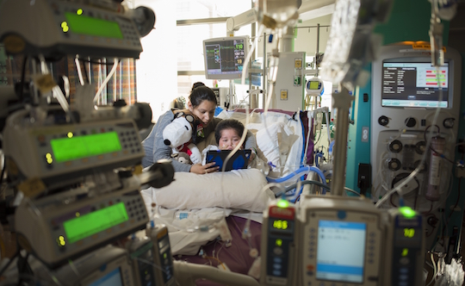
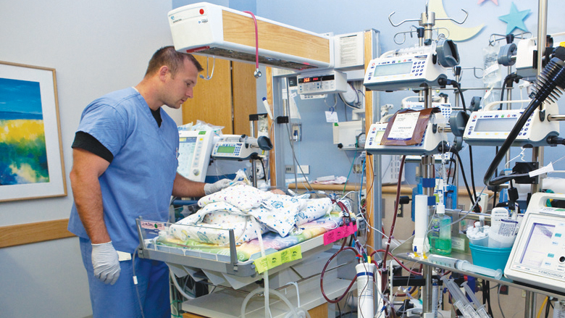

The Problem of Patient Deteoriation
Notes:
Patients in ICUs require high level of care as compared to patients in other units in the hospital. The condition of certain patients can deteriorate quickly which require sudden attention from the medical staff. This can often times prove challenging especially if risk stratification is needed for resource allocation for the medical staff, a problem that has especially become prominent in the post COVID-19 world.
House Supervisors have a limited number of resources in staffing and beds and thus having a list of patients who may be at higher risk of transitioning to ICU can help to prioritize where the high risk patients may go and also facilitate discharge of patients who are improving and no longer need ICU levels of care.

Slide 5
Risk Scoring Models in Healthcare
AGPAR Scoring System, a risk score for newborns still used today, proposed in 1952 Glasgow
Coma Scale is used to assess an individual’s neurologic status by evaluating three subscores: eye, verbal, and motor responses
The APACHE score links the risk of mortality to the number of organs failed
The most widely used pediatric mortality risk score is the PRISM score developed by Pollack.
PRISM III score which has 17 physiologic variables (e.g., vital signs, blood gas measures, and lab results from metabolic tests, blood counts, and clotting studies)
The Pediatric Index of Mortality (PIM) is another metric that is used for mortality prediction for pediatric ICU populations
Notes:
PRISM is a physiologically based score used to quantify the physiologic derangement of a pediatric patient. When combined with other variables, it can be used to compute expected mortality risk

Slide 6
Dataset
HealthFacts dataset created by Cerner
Timespan: January 2009 to June 2016
1,901,437 records and 42,581 encounters
The data can be divided into five broad categories:
Pharmacy data
Lab data
Billing data (codified diagnosis, procedure codes)
Clinical events (vital signs, pain, sedation, coma scales, respiratory, therapy etc.)
Microbiology (culture details, organisms isolated, antimicrobial medications, susceptibles)
Notes:
Patients who died (768) were excluded from analysis

Slide 7
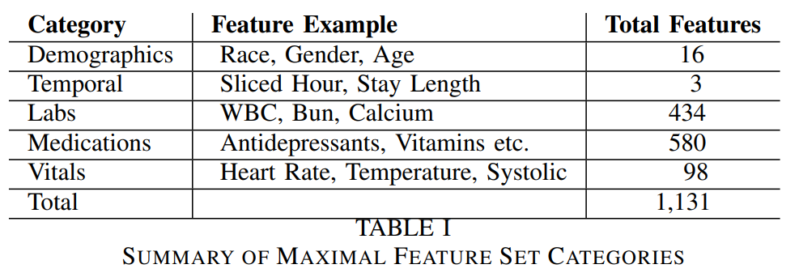
Feature Set
Notes:
The majority of the encounters have more than 5 or more records associated with them. Data cleansing included: a) eliminating duplicate and null values; and b) eliminating data inconsistent with valid entries (e.g. admission times of zero, data inconsistent with life, or negative values).

Slide 8
Pediatric Cohort
Cohort A
Age in years is not missing
Age in years <= 21
Age in hours > 0 OR Age in hours is not missing
At least one care setting in (55, 56, 57 ,59, or 60) from source in (lab order, medication dispensed medication request, discharge care setting)
Cohort B
Age in years is not missing
Age in years <= 21
Age in hours > 0 OR Age in hours is not missing
Patient type is inpatient

Slide 9


Predicting Patient State
not ICU
Transition
ICU
Predict the current and future states,
Patient’s condition in next n time steps (n = 1,2,3,4)
Useful for risk stratification and preemptive measures
Labels and some features are defined by a complex logic

Slide 10

Model Setup
Current State
Future State 1
Future State 2
Future State 3
Prediction Problem | Binary Classification
Prediction Entity | Encounter
Prediction Time Range | 4-hour time steps
Classes | ICU, not-icu
Validation | 10-Fold Cross Validation
Algorithms | Decision Trees, AdaBoost with Decision Stump, Naive Bayes, SVM, Random Forest (RF) and XGBoost)

Slide 11
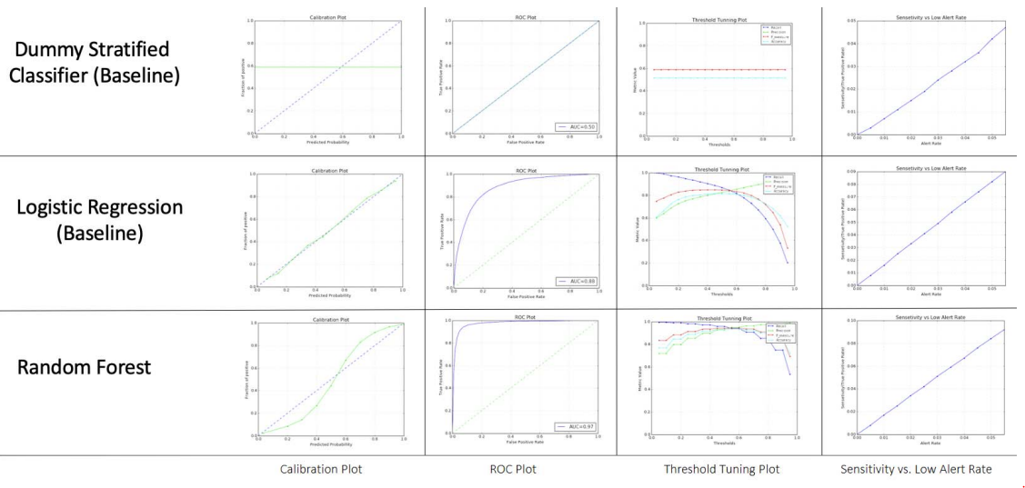
Experiments: Predicting Future State 1
Notes:
A summary of prediction results for predicting the next future state are given in the Figure. The plots in Figure 1 reveal that the Random Forest model is sufficiently calibrated, although model calibration can be improved further. The AUC of the model is 0.97 and the threshold tuning plots also reveal that the model has sufficiently good predictive power as measured by precision and recall. Lastly, the SLA (Sensitivity vs. Low Alert Rate) plots reveal that the model does not degrade when the model confidence is low.

Slide 12
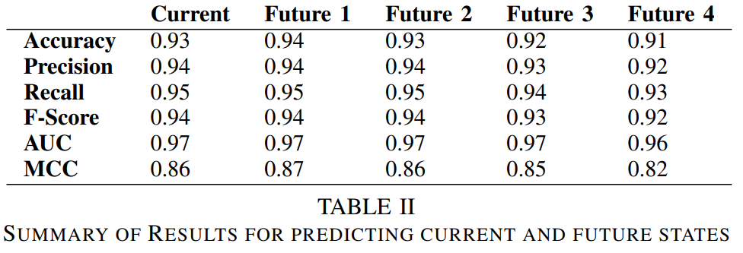
Experiments: Predicting Current and Future States
Notes:
The tables demonstrate that the sufficiently high results are obtained across the board for predicting future states. We also computed the Matthews Correlation Coefficient for the results in Table I since this metric is generally regarded as a good way to capture different aspects of a Confusion Matrix in a single number. The overall performance gives us confidence that the models perform sufficiently well.

Slide 13
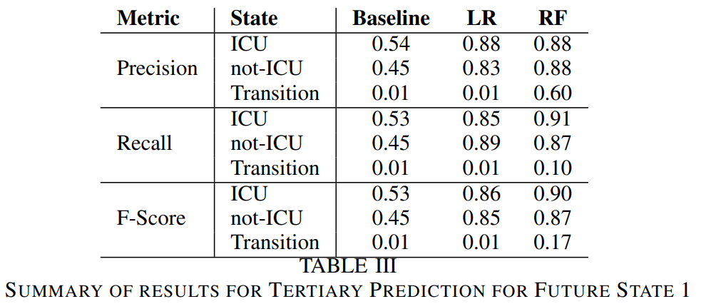
Experiments: Predicting Transition States
Notes:
For the tertiary classification problem we used the same exact prediction setup i.e., the same set of classifiers were used with 10-fold cross validation. baselines. Here the baseline refers to the stratified baseline where the prediction is based on random prediction with respect to the relative distribution of the classes.

Slide 14
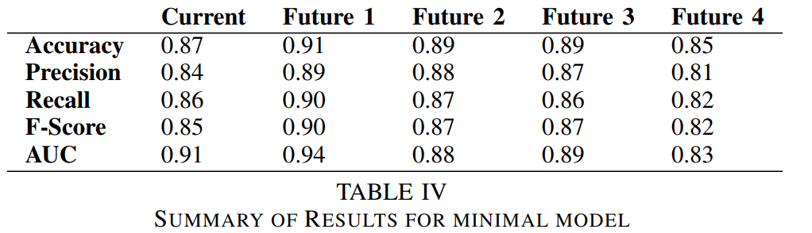
Experiments: Minimal Model

Slide 15
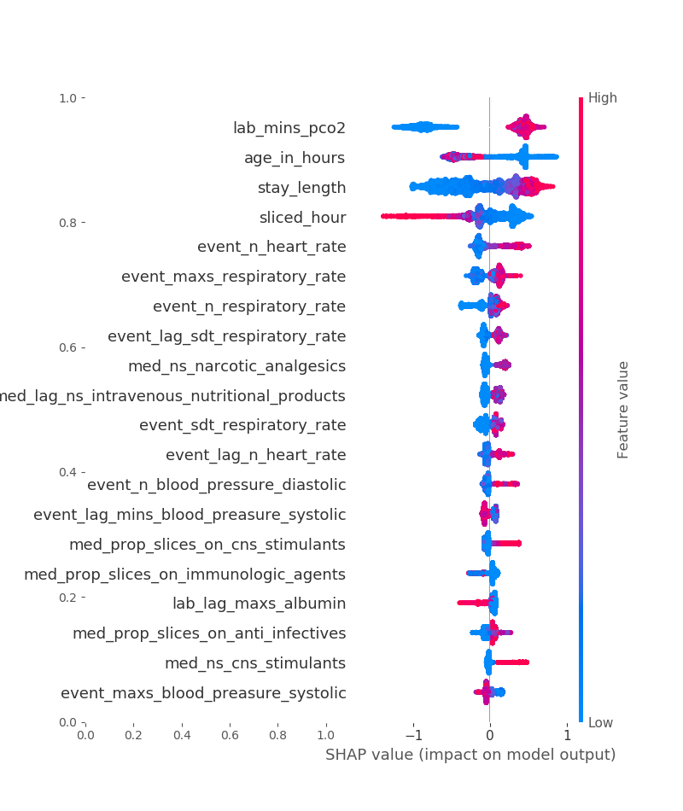
Global Feature Importance (Next Future State)
Feature Importance Plot
Key Takeaways
Demographics:
Age in hours in an important feature
Utilization:
Length of stay is an important feature
Vitals:
Heart rate is an important feature
Max respiratory rate is an an important feature
Labs:
PCO2 is an important factor with the population bifurcated into two subsets, one with high importance and another with low importance
Notes:
For model transparency we employed the SHAP framework [18], a summary of the top factors is given in Figure 2. The global factors that were identified by the model was a mix of expected and unexpected features e.g., pCO2 (partial pressure of carbon dioxide is the measure of carbon dioxide within arterial or venous blood) is an important factor with the population bifurcated into two subsets, one with high importance and another with low importance. Vital signs (heart rate, max respiratory rate etc) are highly represented as top features. Receiving medications from the following classes were present: narcotic analgesics, CNS stimulants, and antiinfectives are associated with future ICU care. Higher levels of Albumin are negatively associated with the positive class. Additionally, very young age (age measured in hours) is associated with increased risk for ICU care.

Slide 16
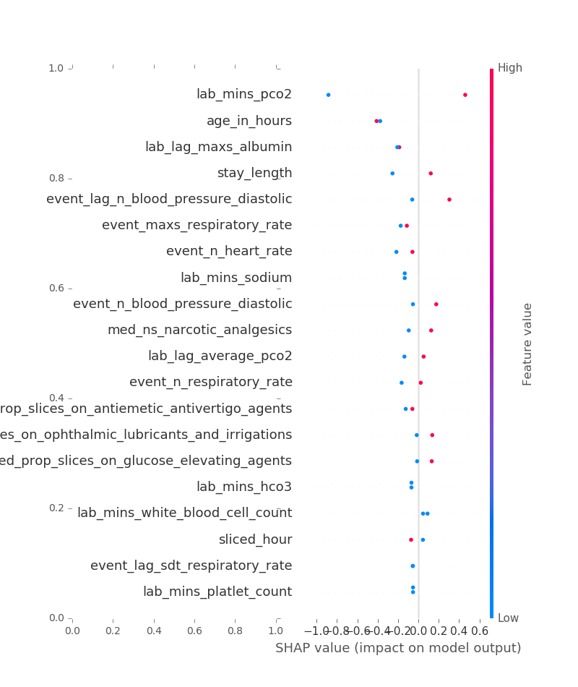
Cohort Feature Importance: Outliers
Features Importance Plot
Example:
Encounter A
True Positive (High PCO2)
Prediction Prob: 0.78
Encounter B
False Positive (Low PCO2)
Prediction Prob: 0.54
Encounter similarity: 0.72
Normalized Features Euclidean Distance

Slide 17
Conclusion & Future Directions
Predicting the future state of patients in Pediatric Intensive Care Units (PICU) is a far-reaching problem
Methods that are currently being used for gauging pediatric mortality risk are mostly scoring based systems but can be complemented via ML models
Our long-term goal is to create a risk scoring system that can be used in lieu of current risk scoring systems used in PICUs
Additionally, for future work, we propose to integrate the models described in this manuscript in a platform that may be integrated into the workflow of physicians and other healthcare personnel
Notes:
for patient quality of life and even patient survival.
Machine learning models can be used for predicting patient states in PICUs

Slide 18
Q&A
Muhammad Aurangzeb Ahmad^{1,2,*}, Eduardo Antonio Trujillo Rivera^{3,4}, Murray Pollack M.D.³, Carly Eckert M.D.¹, Anita Patel M.D³ and Ankur Teredesai⁵
* Corresponding author: muhammad@kensci.com

Slide 19
Appendix

